Slide 1
Lending Home Data Challenge
Aram Moghaddassi

Slide 2
Central Question:
How has the loan market changed over the last five years, and how does that influence Lending Home’s future strategy?

Slide 3
Roadmap
1. Data summary
2. Market overview and Lending Home’s relative performance
3. Recommendations, evaluation metrics, and further analysis

Slide 4
Data Summary

Slide 5
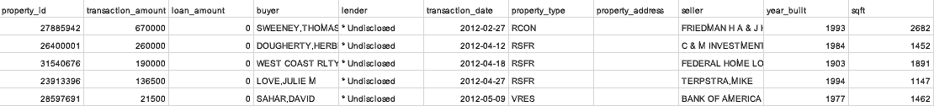
All “Fix and flip” transactions in California since 2012.
Roughly 150k recorded purchases.
Roughly 70% of all transactions have undisclosed lenders.
Last full year of data was 2016.

Slide 6
Main columns used in analysis
transaction_date: The date on which transaction documents were filed, when available.
loan_amount: Dollar amount for the loan on the transaction.
lender: Name of lender.

Slide 7
Market Overview and Lending Home’s Relative Performance

Slide 8
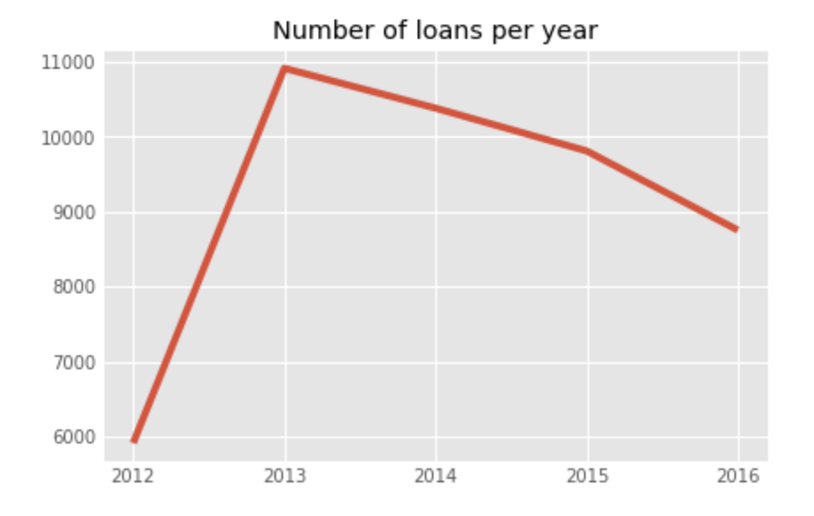
Number of loans issued per year is decreasing: -5% from 2014 to 2015; -11% from 2015 to 2016.

Slide 9
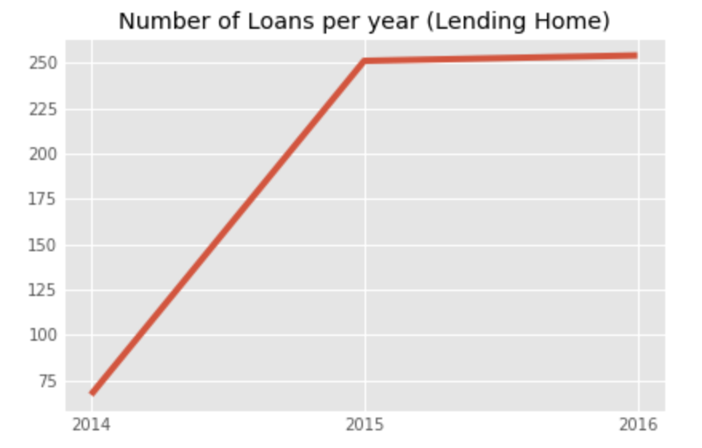
Lending Home’s number of loans spiked in 2015, and continued to grow in 2016 by ~1%.

Slide 10
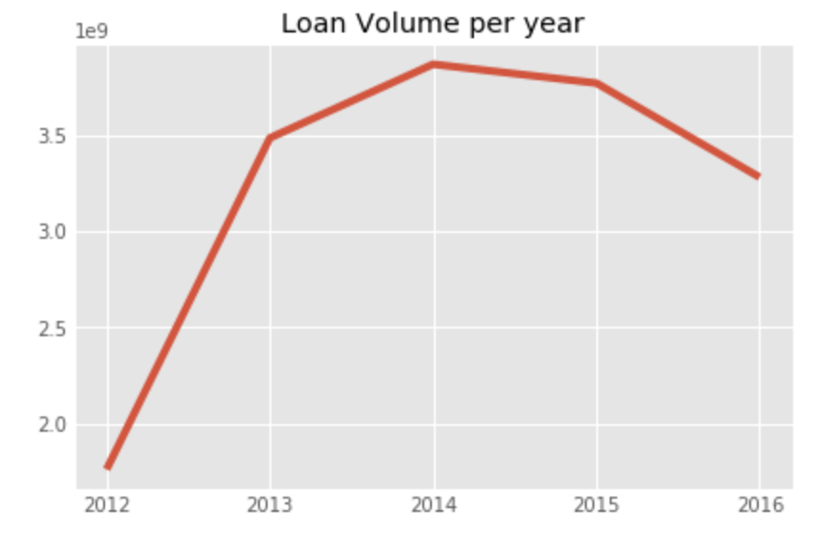
Total loan transaction volume ($) is decreasing: -2% from 2014 to 2015; -13% from 2015 to 2016.

Slide 11
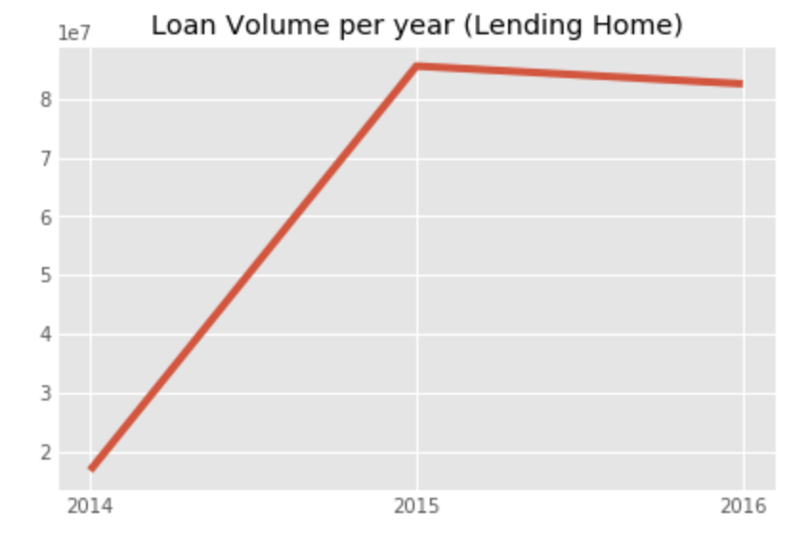
After spiking in 2015, loan volume decreased by ~3% in 2016 (10% higher than the market average).

Slide 12
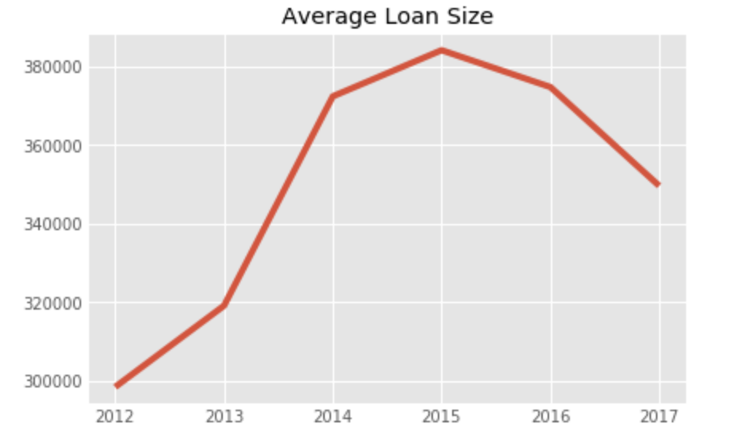
Average loan size increased till 2015, and has been decreasing since.

Slide 13
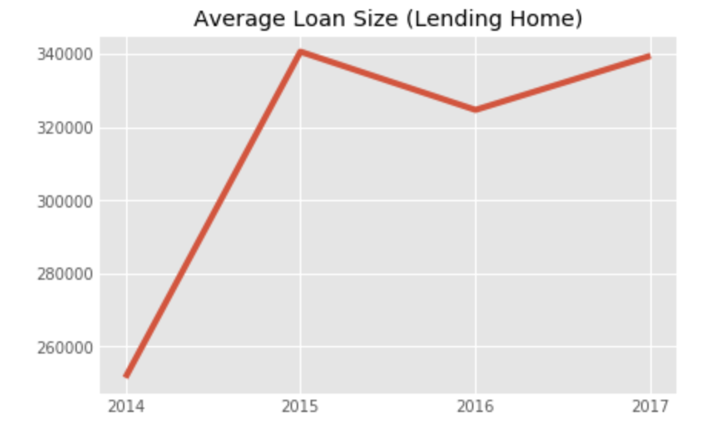
After spiking in 2015, Lending Home’s average loan size has remained relatively constant.

Slide 14
Lending Home’s Position in the Market
Lending Home does, on average, smaller loans compared to the market.
~$370,000 average loan size for the market in 2016.
~$325,000 average loan size for Lending Home in 2016.

Slide 15
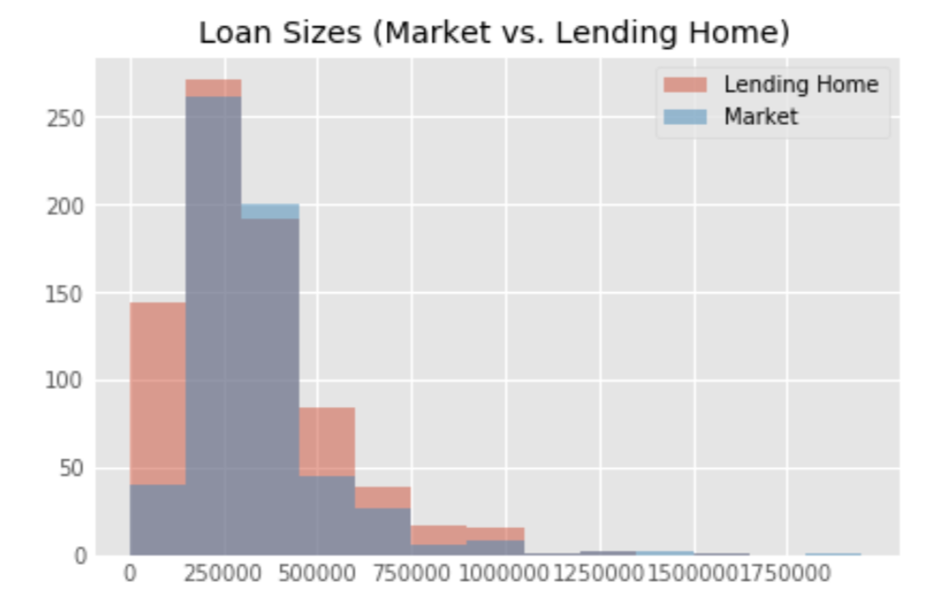
Lending Home’s Position in the Market

Slide 16
Recommendations

Slide 17
Lending Home should offer and market more small loans (< $300,000)
Average loan size has been decreasing the last few years, and the market for larger loans has been shrinking.
Lending Home has been able to substantially beat market growth rates by offering lower loan sizes on average.
More small loans has a lower default risk compared to fewer large loans, since the risk is spread across many borrowers and is thus more diversified.
Notes:
- Concluded that the market for larger loans is shrinking b/c the average loan size has been decreasing, and the number of deals has also been decreasing. This implies less larger deals since if the average and the number of deals has been decreasing, there must be less large deals.

Slide 18
Evaluation metrics for the recommendation
By promoting smaller loan sizes to certain customers, and running A/B tests, we can determine if there is substantial interest for these loans among Lending Home’s existing customers.
As was done in this analysis, we can continue to compare loan volume and quantity metrics for Lending Home vs. the market to determine if the trend of lower loan sizes is persisting.
Comparing the loss due to default with average loan size will directly quantify whether smaller loans yield less default risk.

Slide 19
Further Analysis
Additional data that includes transactions outside of the subset of provided data could be used to determine broader market trajectories.
More specific data about Lending Home customers (age, income, credit score, etc.) could be used to better quantify the feasibility and upside of offering smaller loans.

Slide 20
Tools used
Python3/Jupyter Notebooks
Libraries: numpy, pandas, matplotlib

